Slide 1
Quadratics
Linear graphs
y = mx+c
Parallel
Plotting graphs by
substitution into
equations
Perpendicular
Solving
Quadratic & Linear
Equations
ax²+bx+c
(x+#)(x+#)
Expanding
Brackets
Factorising
ax²+bx
x(ax+b)
x²-y²
(x+y)(x-y)
Quadratic
Graphs
Expanding
Double
Brackets
Solving
Quadratics
(Factorising)
Solving
Quadratic
Equations
Solving
Linear
Equations
Solving
Quadratics
(Completing the Square)
Solving
Quadratics
(Equation)

Slide 2
Return to main page
x x 2
x x² 2x
3x 6
x² + 5x + 6
x a 6
a a² 6a
4 4a 24
a² + 10a + 24
x c 4
c c² 4c
3 3c 12
c² + 7c + 12
x r 7
r r² 7r
2 2r 14
r² + 9r + 14
x y 5
y y² 5y
3 3y 15
y² + 8y + 15
x t 3
t t² 3t
8 8r 24
r² + 11r + 24
x k 2
k k² 2k
6 6r 12
k² + 8k + 12
x d 2
d d² 2d
8 8d 16
d² + 10d + 16
x f ⁻2
f f² ⁻2f
5 5f ⁻10
f² + 3f + ⁻10
x g ⁻4
g g² ⁻4g
2 2g ⁻8
g² + ⁻2g + ⁻8
x e ⁻2
e e² ⁻2e
1 e ⁻2
e² + ⁻e + ⁻2
x b ⁻1
b b² ⁻b
4 4b ⁻4
b² + 3b + ⁻4

Slide 3
Expanding Double Brackets
Return to main page
27d² - 42d + 8
18q² – 54q + 16
x² - 4
t² - 16
t² + 4t + 4
9t² + 30t + 25

Slide 4
Factorising Quadratics
Return to main page
Examples
Factors of
10
Factors of
⁻10
10
5
1 ⁻10
⁻1 10
⁻5
⁻2 5
x 5
x ⁻5
x
2
x²
x
2
x²
7x
That add to 7
⁻ 3x
10
⁻ 10
(x +2)(x+5)
(x +2)(x-5)
That add to ⁻ 3
Factors of
15
x ⁻5
15
⁻1 ⁻15
3 5
⁻ 3 ⁻5
2x
⁻3
2x²
⁻ 10x
⁻ 13x
⁻ 3x
15
(2x -3)(x-5)
Whereby add to ⁻ 13

Slide 5
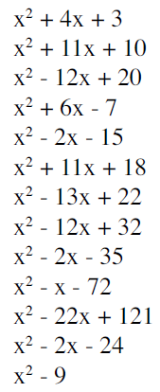
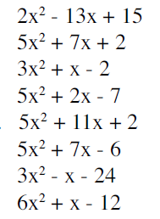
Factorising Quadratics
Return to main page
(x +1)(x+3)
(x +1)(x+10)
(x -2)(x-10)
(x -1)(x+7)
(x +3)(x-5)
(x +2)(x+9)
(x -2)(x-11)
(x -4)(x-8)
(x +5)(x-7)
(x +8)(x-9)
(x-11)(x-11)
(x +4)(x-6)
(x +3)(x-3)
(2x -3)(x+5)
(5x +2)(x+1)
(3x -2)(x+1)
(5x -1)(x+7)
(5x +1)(x+2)
(5x -3)(x+2)
(3x +8)(x-3)
(2x +3)(3x-4)

Slide 6
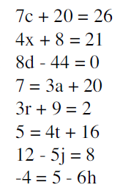
Return to main page
Solving Linear Equations
c=
x=
d=
a=
r=
t=
j=
h=

Slide 7
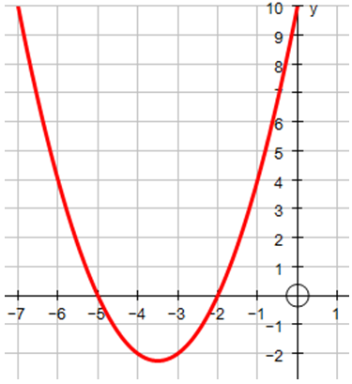
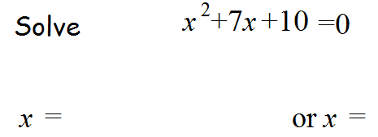
Solving Quadratics (Factorising)
Return to main page
(x +5)(x+2) = 0
x +5 = 0
x +2 = 0
Making the equation x² +7x + 10= 0
Means where does the graph of y = x² +7x + 10 cross the line
y = 0
Where does the graph of y = x² +7x + 10 cross the line
x = 0 / y axis

Slide 8
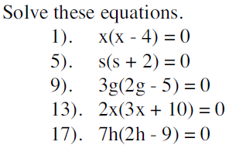
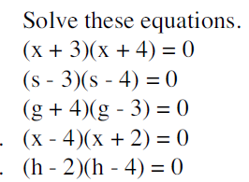
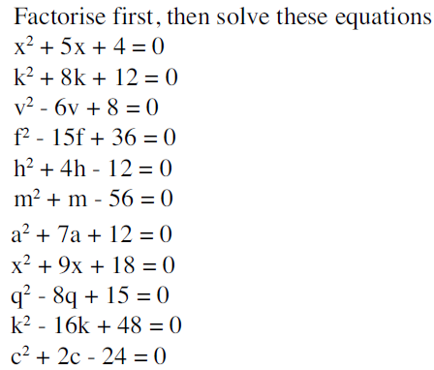
Solving Quadratics (Factorising)
Return to main page
x = 0 x = 4
s = 0 s = ⁻2
g = 0 g = 2½
x = 0 x = ⁻3⅓
h = 0 h = 4½
x = ⁻3 x = ⁻4
s = 3 s = 4
g = ⁻4 g = 3
x = 4 x = ⁻2
h = 2 h = 4
x = ⁻1 x = ⁻4
k = ⁻2 k = ⁻6
v = 2 v = 4
f = 3 f = 12
h = 2 h = ⁻6
1) x = 0 x = 5
5) k = 0 k = 8
9) v = 0 v = 7
13) t = 0 t = 1½
17) h = 0 h = 2⅓
2) a = 0 a = ⁻6
6) x = 0 x = ⁻12
10) q = 0 q = 5
14) k = 0 k = ⁻ 2½
18) c = 0 c = 4½
m = 7 m= ⁻ 8
a = ⁻ 3 a = ⁻ 4
x = ⁻3 x = ⁻ 6
q = 3 q = 5
k = 4 k = 12
c= 4 c = ⁻6

Slide 9
Solving Quadratics (Completing the Square)
Return to main page
Principle
(x +3)(x+3) = (x+3)²
x x 3
x x² 3x
3x 9
x² + 6x + 9
This sum of x terms will always be double the number being squared
6x
Going the other way – to complete the square
x² + bx + c
(x+b)²
²
Solve:
x² +8x + 10= 0
(x+4)² – 16 + 10 = 0
This is required because (x+4)² = x² +8x + 16 so we need to subtract the 16 to preserve the value of the equation
(x+4)² - 6 = 0
(x+4)² = 6
x = ⁻4 ⁺⁄₋√6
x+4 = √6
x+4 = ⁺⁄₋√6

Slide 10
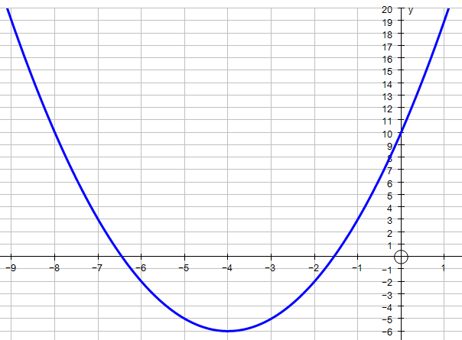
Solving Quadratics (Completing the Square)
Return to main page
What does completing the square tell us about the graph of
y = x² +8x + 10
y = (x+4)² - 6
Because (x+4)² is squared it is always positive,
the smallest value it can have is 0
Therefore the smallest possible value of y is ⁻6
This happens when x is ⁻4
The equation of the
line of symmetry is:
x = ⁻4

Slide 11
Solving Quadratics (Completing the Square)
Return to main page
In summary
y = x² +8x + 10
½ of 8
10 - 4²
y = (x+4)² - 6
The equation of the
line of symmetry is:
x = ⁻4
The minimum
y value ⁻6
Coordinates of the minimum
(⁻4 ,⁻6)

Slide 12
Solving Quadratics (Completing the Square)
Return to main page
For each equation identify the equation for the line of symmetry and the minimum

Slide 13
Solving Quadratics (Equation)
Return to main page

Slide 14
Plotting graphs by substitution into equations
Return to main page

Slide 15
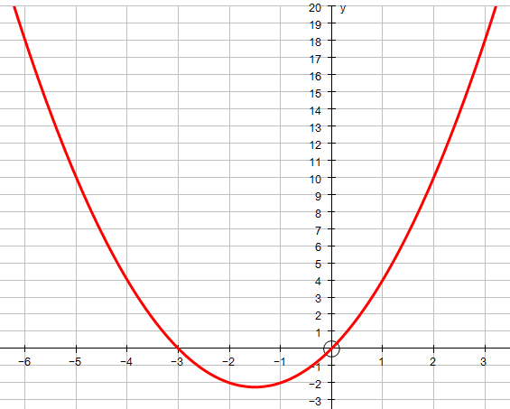
Plotting graphs by substitution into equations
Return to main page
18 4 0 -2 4 10 18

Slide 16
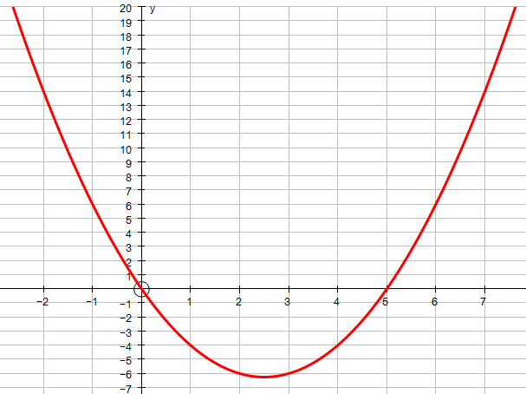
Plotting graphs by substitution into equations
Return to main page
6 0 -4 -6 -4 0 6 14

Slide 17
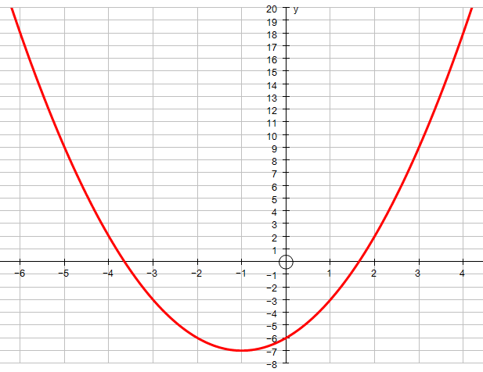
Plotting graphs by substitution into equations
Return to main page
18 9 -3 -6 -6 -3 2 9 18

Slide 18
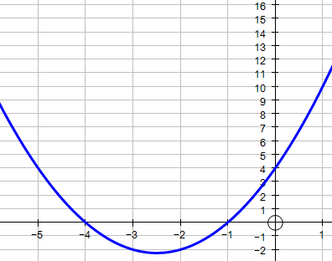
Sketching graphs by using all the information
Return to main page
Sketch the graph of the following equation:
y = x² + 5x + 4
Using the line of symmetry
Crosses the y-axis at 4
Factorises to:
(x+1)(x+4)
Completing the square:
(x+2½)²-2¼ = 0
Solutions for:
(x+1)(x+4)=0
Are
x = ⁻1 x = ⁻4
Line of symmetry
x = ⁻2½
minimum coordinates
(⁻2½, 2¼)
y = x² - 10x + 25
y = x² + 4x - 21

